Slide 1

Gym Management System: A Data-Driven Approach
This presentation outlines a comprehensive gym management system designed to streamline data across branches, customers, and resources, empowering gyms to deliver a more personalized and efficient experience.
Team - 4
Shashwat Verma
Sushma Kunjangada Arun
Dale Alphonso
Hasith Reddy
Neha Shethia

Slide 2
Gym Management Overview
Problem
Goal
Current gym management processes often lack efficiency, particularly when managing data across multiple branches, members, and resources.
The Gym Management System is designed to streamline and manage the day-to-day operations of a fitness center or gym. The system will track essential data such as members, staff, trainer information, fitness products, memberships, schedules, and payments. The purpose of this project is to design and implement a database that efficiently stores and organizes information for smooth and accurate management of gym operations.

Slide 3

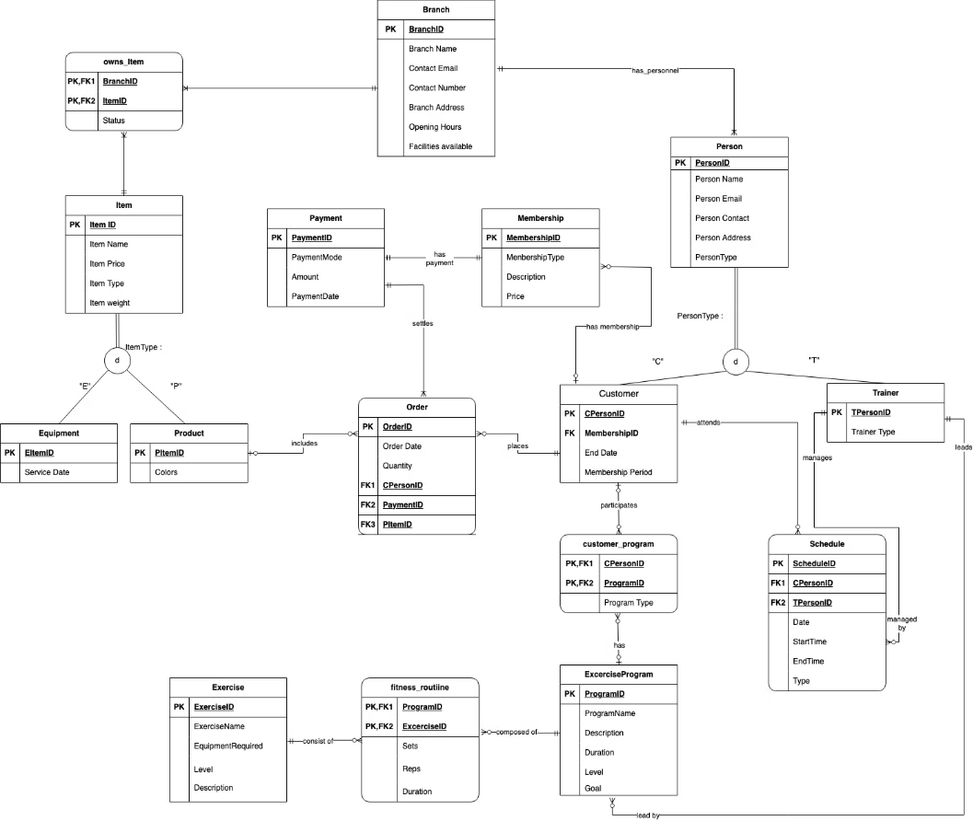
ER Diagram

Slide 4
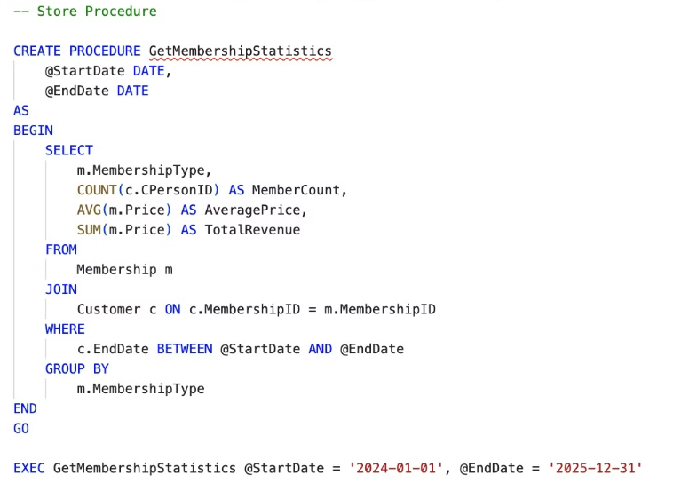
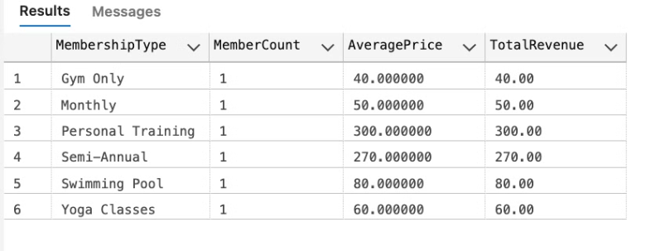
Stored Procedures

Slide 5
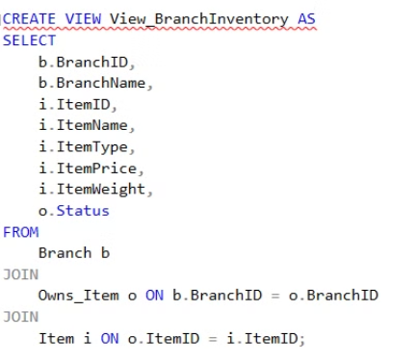
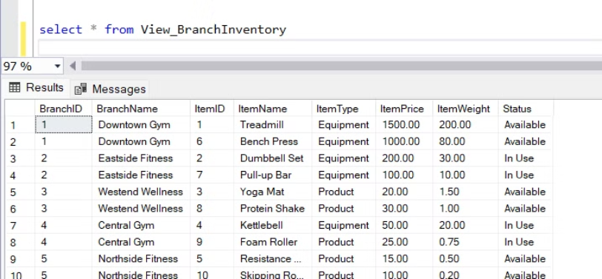
Views

Slide 6
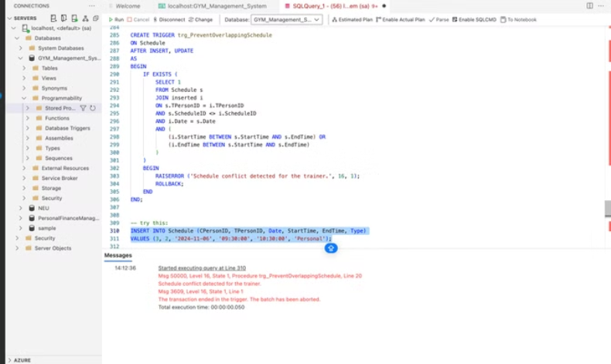
Triggers

Slide 7
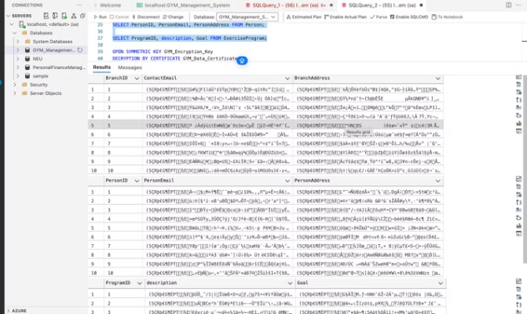
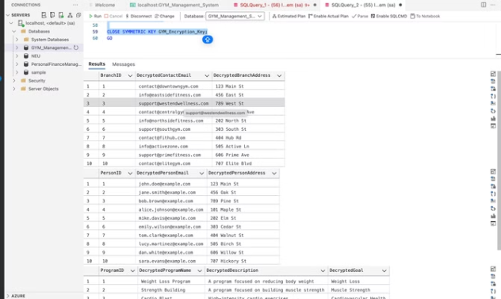
Encryption of Columns

Slide 8
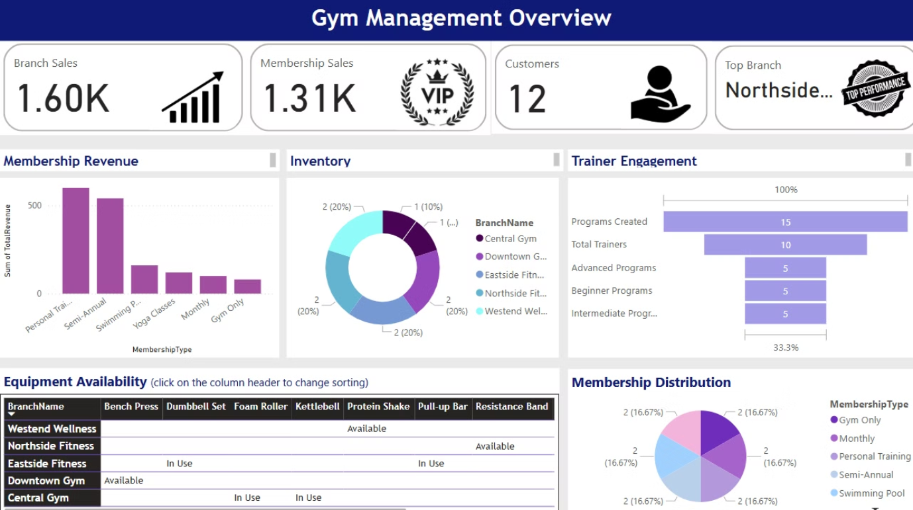
Power BI Report

